Slide 2
The Commerce Mission
Primary economic development agency in the state;
Stimulate private investment and create jobs;
Attract new businesses, grow and retain existing businesses;
Assist with workforce training and financial assistance.
Promotes the state's many economic advantages and markets local products and services at home and abroad to spur economic development and international investment, trade and tourism.

Slide 3
How We Do It
Attract new companies to Maryland through relationships with the site selector community, building and site location assistance, and targeted foreign direct investment strategy
Support Maryland companies with growth through advocacy, consulting, connection to resources, and export assistance
Finance programs, tax credits and job training grants
Strategic industry sector development
Supporting tourism, film and the arts
Marketing:
Blog, email newsletter, social media, publications;
Promoting Maryland and Maryland companies nationally and internationally and at major conferences like BIO, Xponential and InfoSec Europe.

Slide 4
Governor
Lieutenant Governor
Department of Commerce
Secretary of Commerce
Assistant
Attorney
General
Policy, Research
& Gov’t Affairs
Maryland
Economic
Development
Commission
Maryland
P3
Marketing
Corporation
Deputy Secretary
Chief Operating Officer
Administration & Technology
Assistant Secretary
Business & Industry Sector
Development
Assistant Secretary
Marketing, Tourism & the Arts
Information & Technology Management
Business
Recruitment
Strategic
Industries
Budget &
Finance
Marketing
Tourism & Film
Regional Growth
& Retention
International
Investment & Trade
Communications
General
Services
Human
Resources
Maryland State Arts Council
Military &
Federal Affairs
Finance
Programs
Contracts &
Procurement

Slide 5
Business and Industry Sector Development
Office of Business Recruitment & Location Services
Office of Regional Growth & Retention
Office of Strategic Industries & Entrepreneurship
Office of International Investment & Trade
Office of Military & Federal Affairs
Office of Finance Programs
Notes:
We do this by building relationships with economic development organizations, industry groups and businesses so we always know what their needs are and what challenges they may be facing.

Slide 6
Business Recruitment & Location Services
Attracts new businesses to the state;
Works with Site Selection Consultants, Property Owners; Economic Development Partners;
Helps Maryland compete for major projects (e.g. FBI headquarters);
Notes:
We do this by building relationships with economic development organizations, industry groups and businesses so we always know what their needs are and what challenges they may be facing.

Slide 7
Regional Growth & Retention
12-member team, (aka our “regional representatives”) based geographically to assist businesses in every corner of the state.
Coordinate with local Economic Development Partners.
Provide easy access to Commerce programs and services for businesses of all sizes.
Help clients seeking to expand markets, workforce or physical presence within the state.
Regional reps coordinate with counterparts from other agencies through the Regional Resources Workgroup.
Notes:
This division also includes our finance team, which oversees our grant, loan, investment and tax credit programs.

Slide 8
Strategic Industries & Entrepreneurship
Industry sector experts focused on sector development in:
Aerospace (space, unmanned/autonomous vehicles)
Advanced manufacturing
Agribusiness
Clean Energy
Cybersecurity and quantum
Life sciences
Entrepreneurship,
Workforce and Education

Slide 9
International Investment & Trade
Supports Maryland businesses looking to expand into foreign markets or advance export sales; works with foreign businesses looking to establish U.S. presence.
Maryland Global Gateway - soft landing program for foreign businesses.
ExportMD program provides grants to help businesses cover the cost of international marketing, such as trade shows.
Leads delegations to international trade shows such as AUVSI Xponential, MEDICA, Expo Seguridad, Arab Health, Paris Air Show, InfoSecurity Europe.

Slide 10
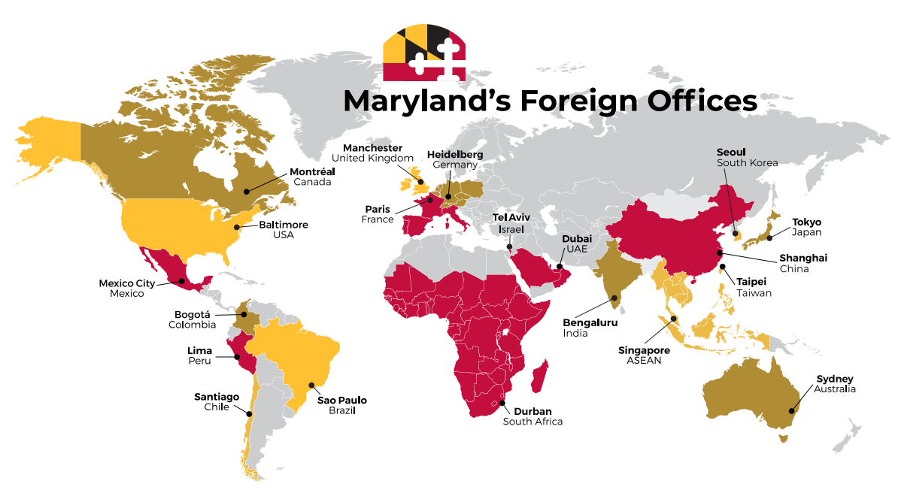
International Investment & Trade

Slide 11
Military and Federal Affairs
Fosters relations between businesses and military installations & federal agencies and laboratories.
Helps businesses create and retain jobs through federal contracts; supports expansion projects such as the Bureau of Engraving and Printing; supports commercialization of military technology (DefTech program).

Slide 12
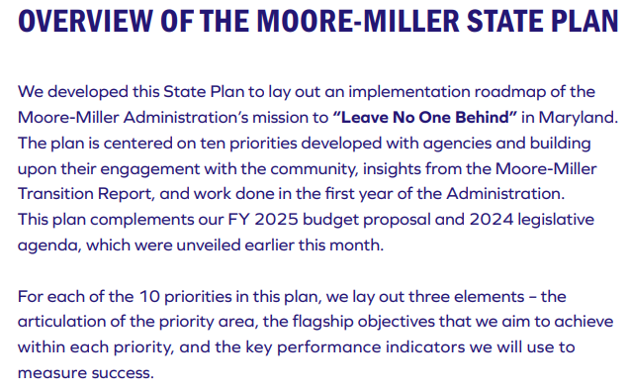
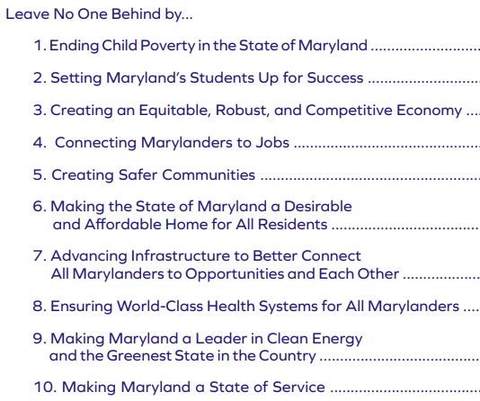
Moore-Miller State Plan

Slide 13
3.1
Develop key sectors
3.1
3.2
3.2
Creating an equitable, robust, and competitive economy
Strengthen and incentivize diverse local small businesses and entrepreneurship
3.3
3.3
Attract and secure federal, private, and foreign investments

Slide 14
10
4.1
4.1
4.2
Help workers move to in-demand occupations
Connecting Marylanders to jobs
4.2
Support Marylanders in accessing quality jobs

